Slide 1
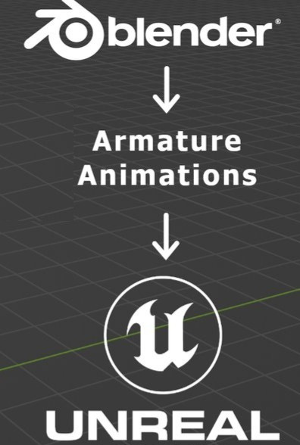
VCET EXPLORERS
BY CSE DEPAETMENT

Slide 2
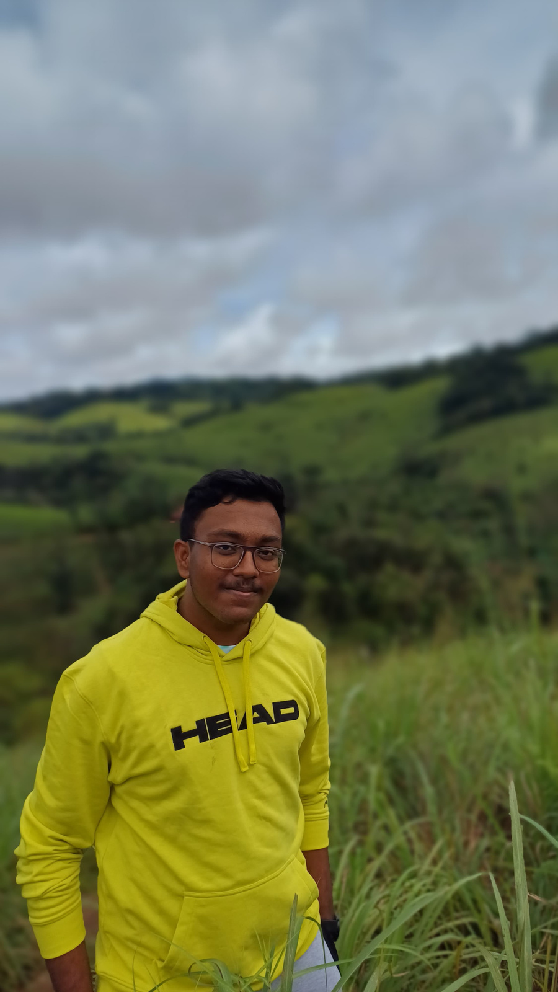
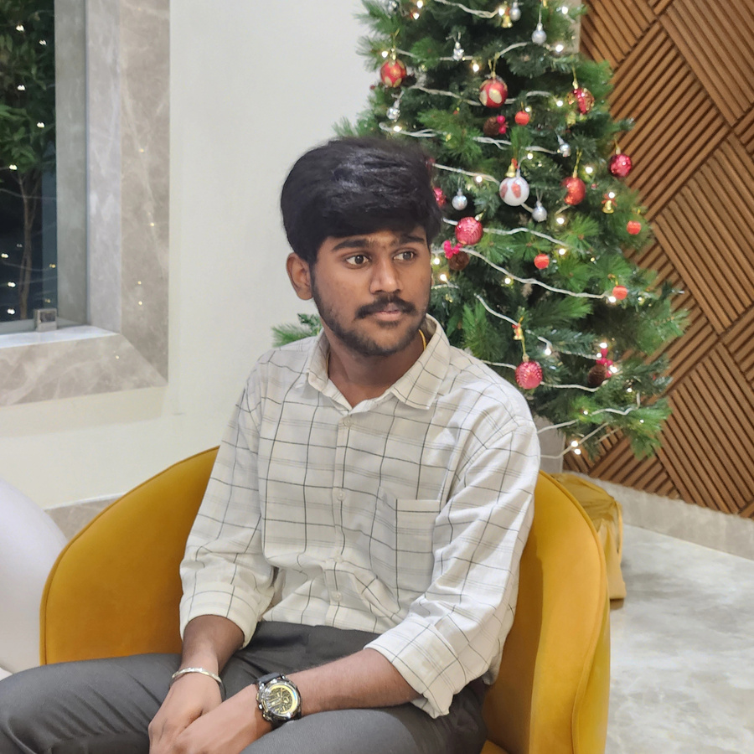
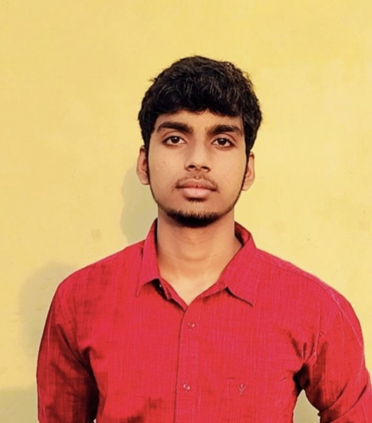
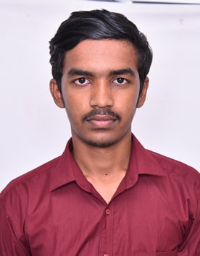
THE TEAM
SHAMRUTHYAGOPAL N
SURIYA N
VISHWARAMANAJUM V
YOGESH K

Slide 3
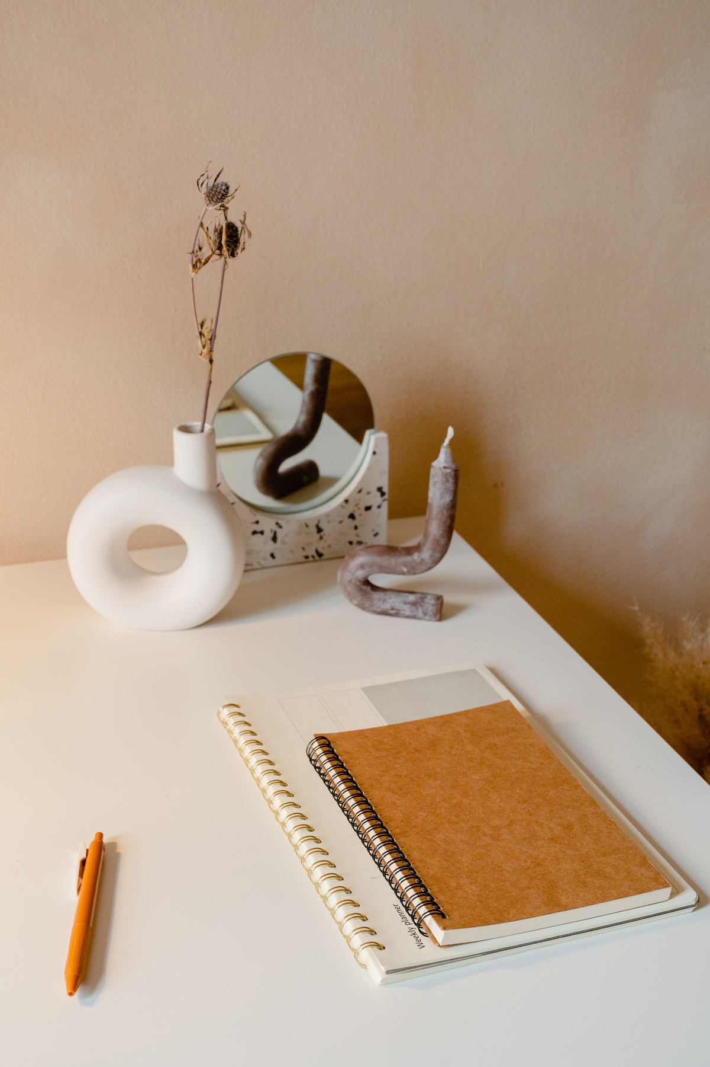

ORIGIN OF THE CREATIVE IDEA
The origin of the creative idea for visualizing your college in 3D modeling stems from the desire to create a realistic and interactive representation of the campus. This idea may be driven by the need to provide an immersive experience for students, staff, and visitors, allowing them to explore the college virtually. Additionally, it serves an educational purpose, helping new students familiarize themselves with the campus layout before arriving. The project could also be inspired by the goal of preserving the college’s architectural details for future reference. Furthermore, advancements in 3D modeling technology offer an innovative way to enhance visualization, making it an exciting challenge for those interested in digital design and virtual environments.

Slide 4

Vision & Mission
1.
To accurately design and develop a 3D representation of the college using advanced modeling techniques.
To create a highly detailed and interactive 3D model of the college that enhances visualization, navigation, and engagement, providing an immersive virtual experience for students, staff, and visitors.
2.
To improve accessibility by offering a virtual tour experience for students and visitors.
3.
To preserve the architectural essence of the college for future reference and innovation.

Slide 5

IDEAS PROCESS
1
2
3
Conceptualization – Identify the purpose, goals, and scope of the 3D modeling project, including key structures and details to be included.
Design & Development – Gather reference materials, such as maps and photos, then use 3D modeling software to build an accurate digital representation of the college.
Implementation & Refinement – Optimize the model for better visualization, add interactive features if needed, and test for accuracy before finalizing the project.

Slide 6
CREATION PROCESS
The creation process of the 3D college visualization project involves several stages, utilizing Unreal Engine and Blender for development. Initially, we gather reference materials such as architectural plans, photos, and measurements to ensure accuracy in modeling. Using Blender, we develop detailed 3D models of the buildings, landscapes, and other campus structures, focusing on realistic proportions and textures. Once the models are created, they are imported into Unreal Engine, where we enhance the environment with lighting, materials, and interactive elements to provide an immersive experience. Optimization techniques are applied to ensure smooth performance, followed by testing and refinements to finalize the project for presentation or practical use.

Slide 7
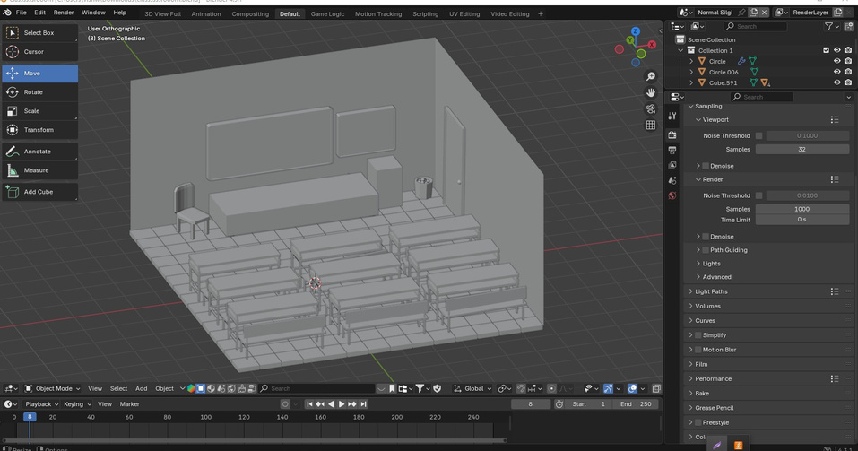
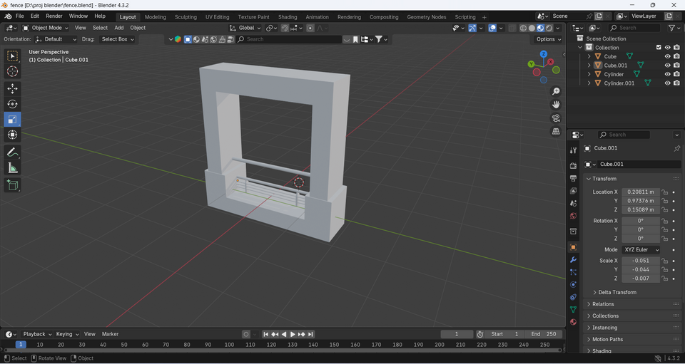

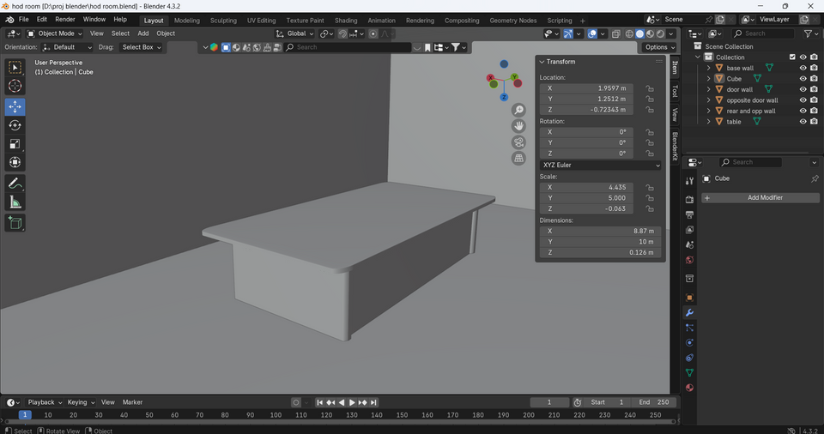
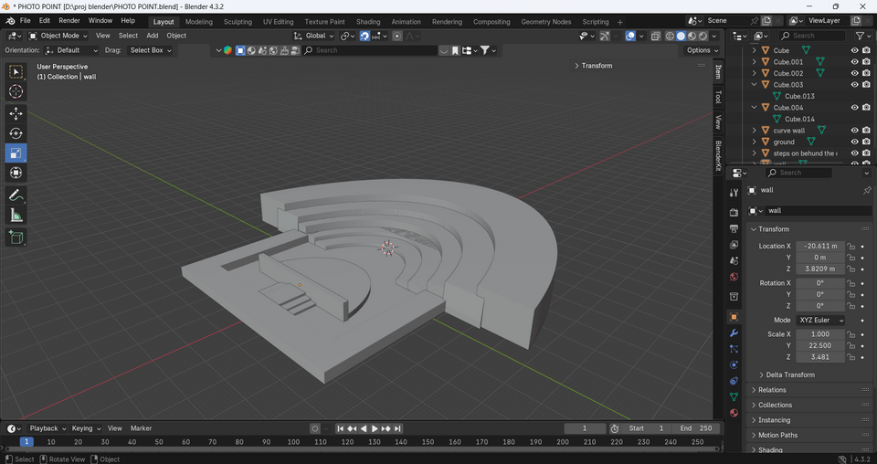
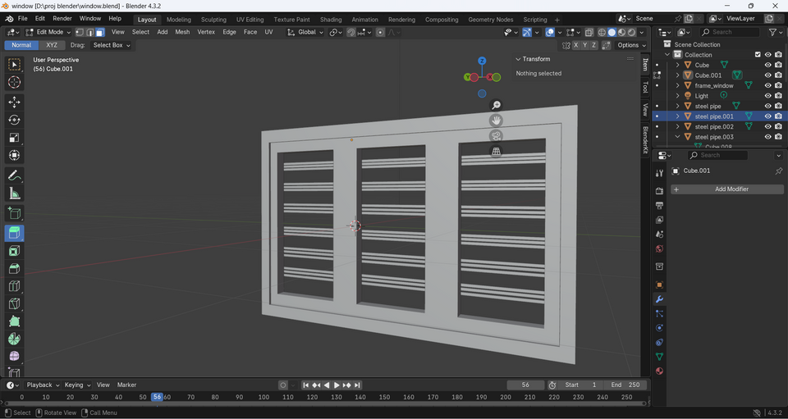
blender

Slide 8

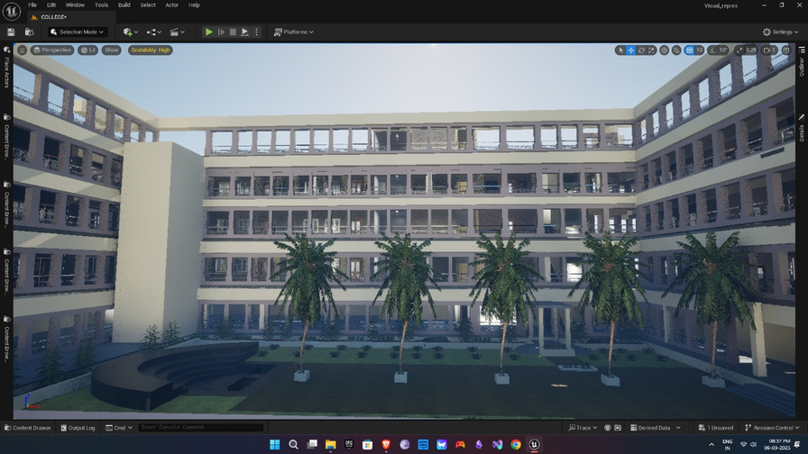
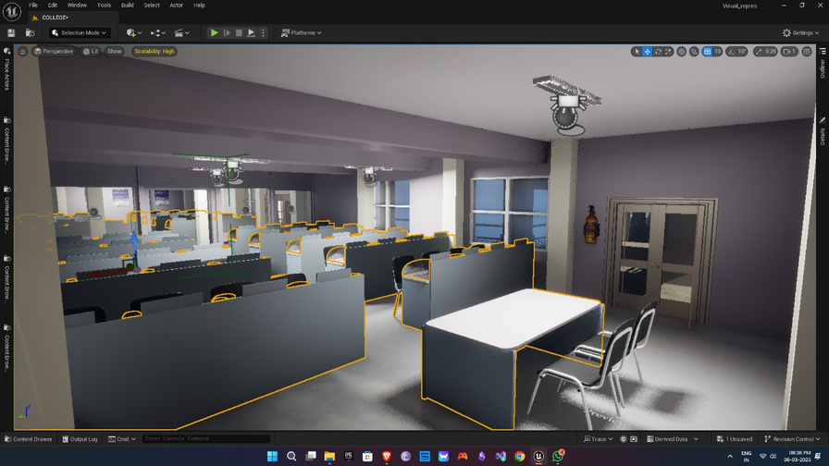
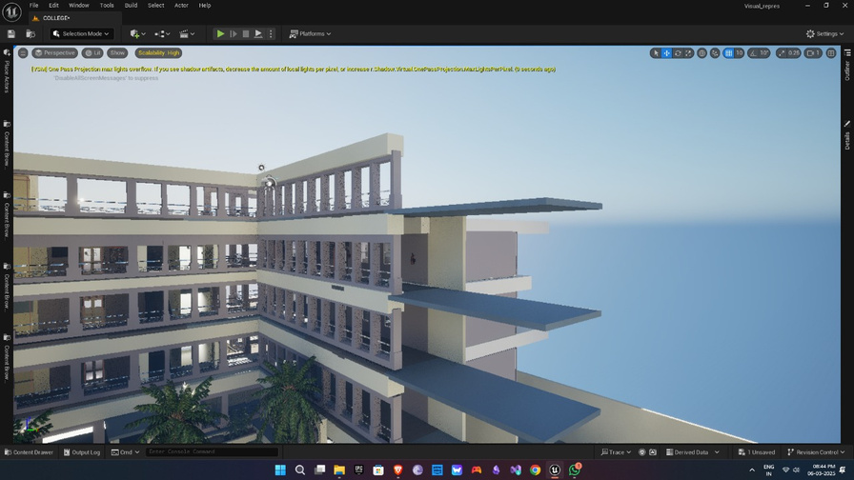
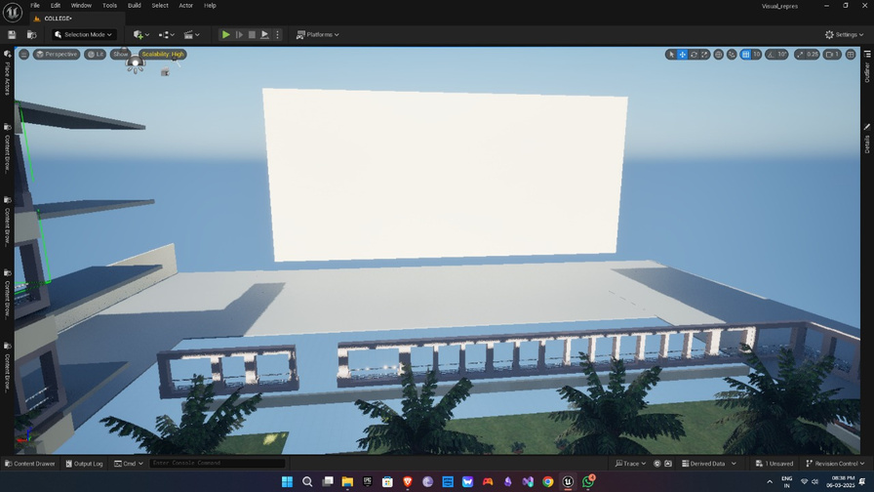
unreal enginee

Slide 9
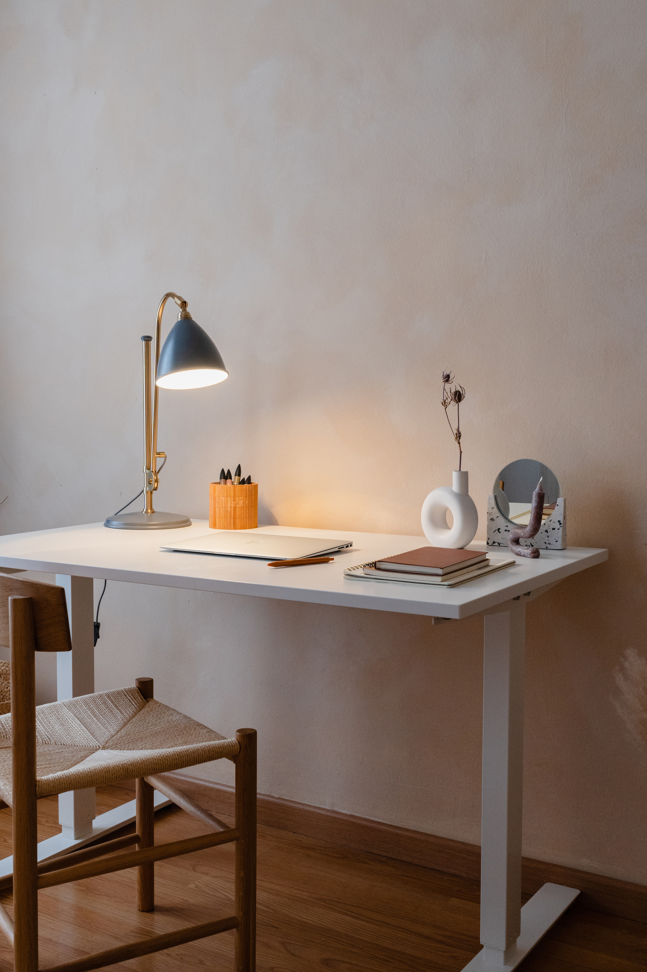
FINAL REFLECTIONS AND FUTURE STEPS
The 3D visualization of our college using Unreal Engine and Blender has been a transformative project, bridging technology and architecture to create an immersive digital experience. This journey has enhanced our skills in modeling, rendering, and interactive environment development. By successfully recreating the college in a virtual space, we have provided a new way to explore and experience the campus.
Moving forward, we plan to further implement the project in Meta Goggles, enabling a fully immersive VR experience. This will allow users to navigate the campus in real-time, enhancing accessibility and engagement. Future improvements will focus on optimizing performance, refining textures, and incorporating interactive elements such as guided tours and user interactions. By continuously evolving the project, we aim to create a dynamic and immersive platform for education, navigation, and digital preservation.

Slide 10
ANY QUESTION?

Slide 11
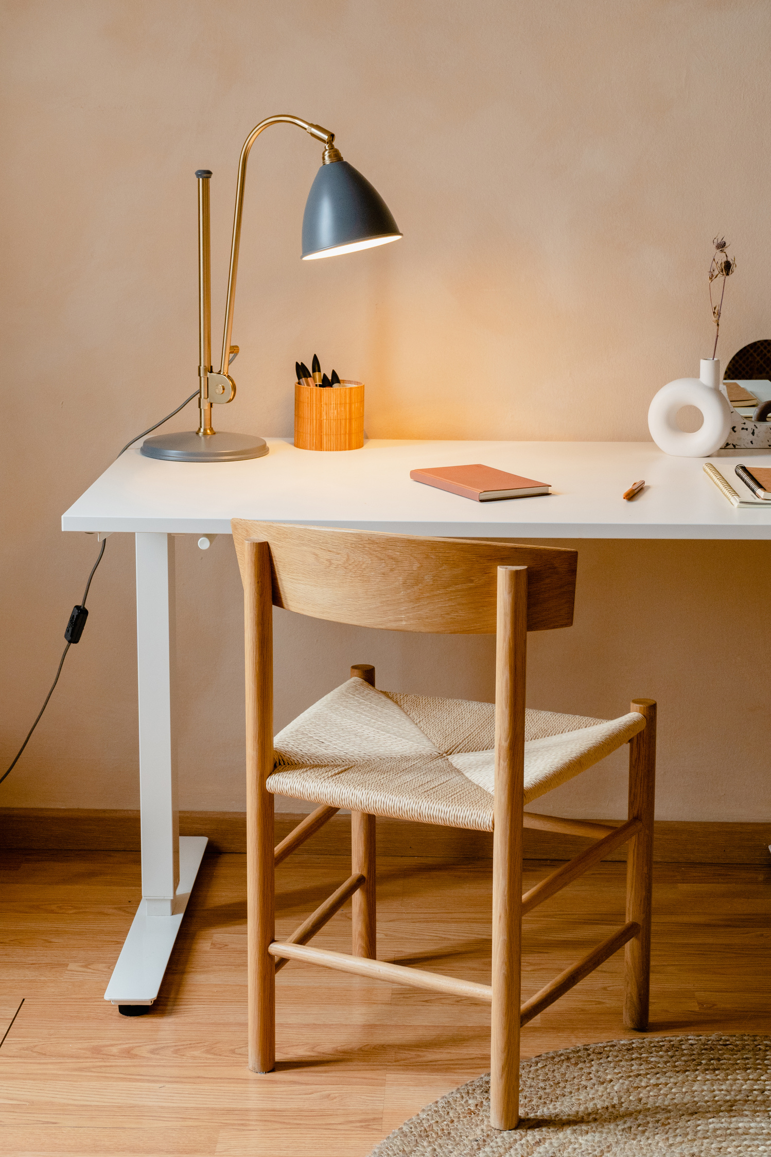
THANK YOU.

